Slide 1

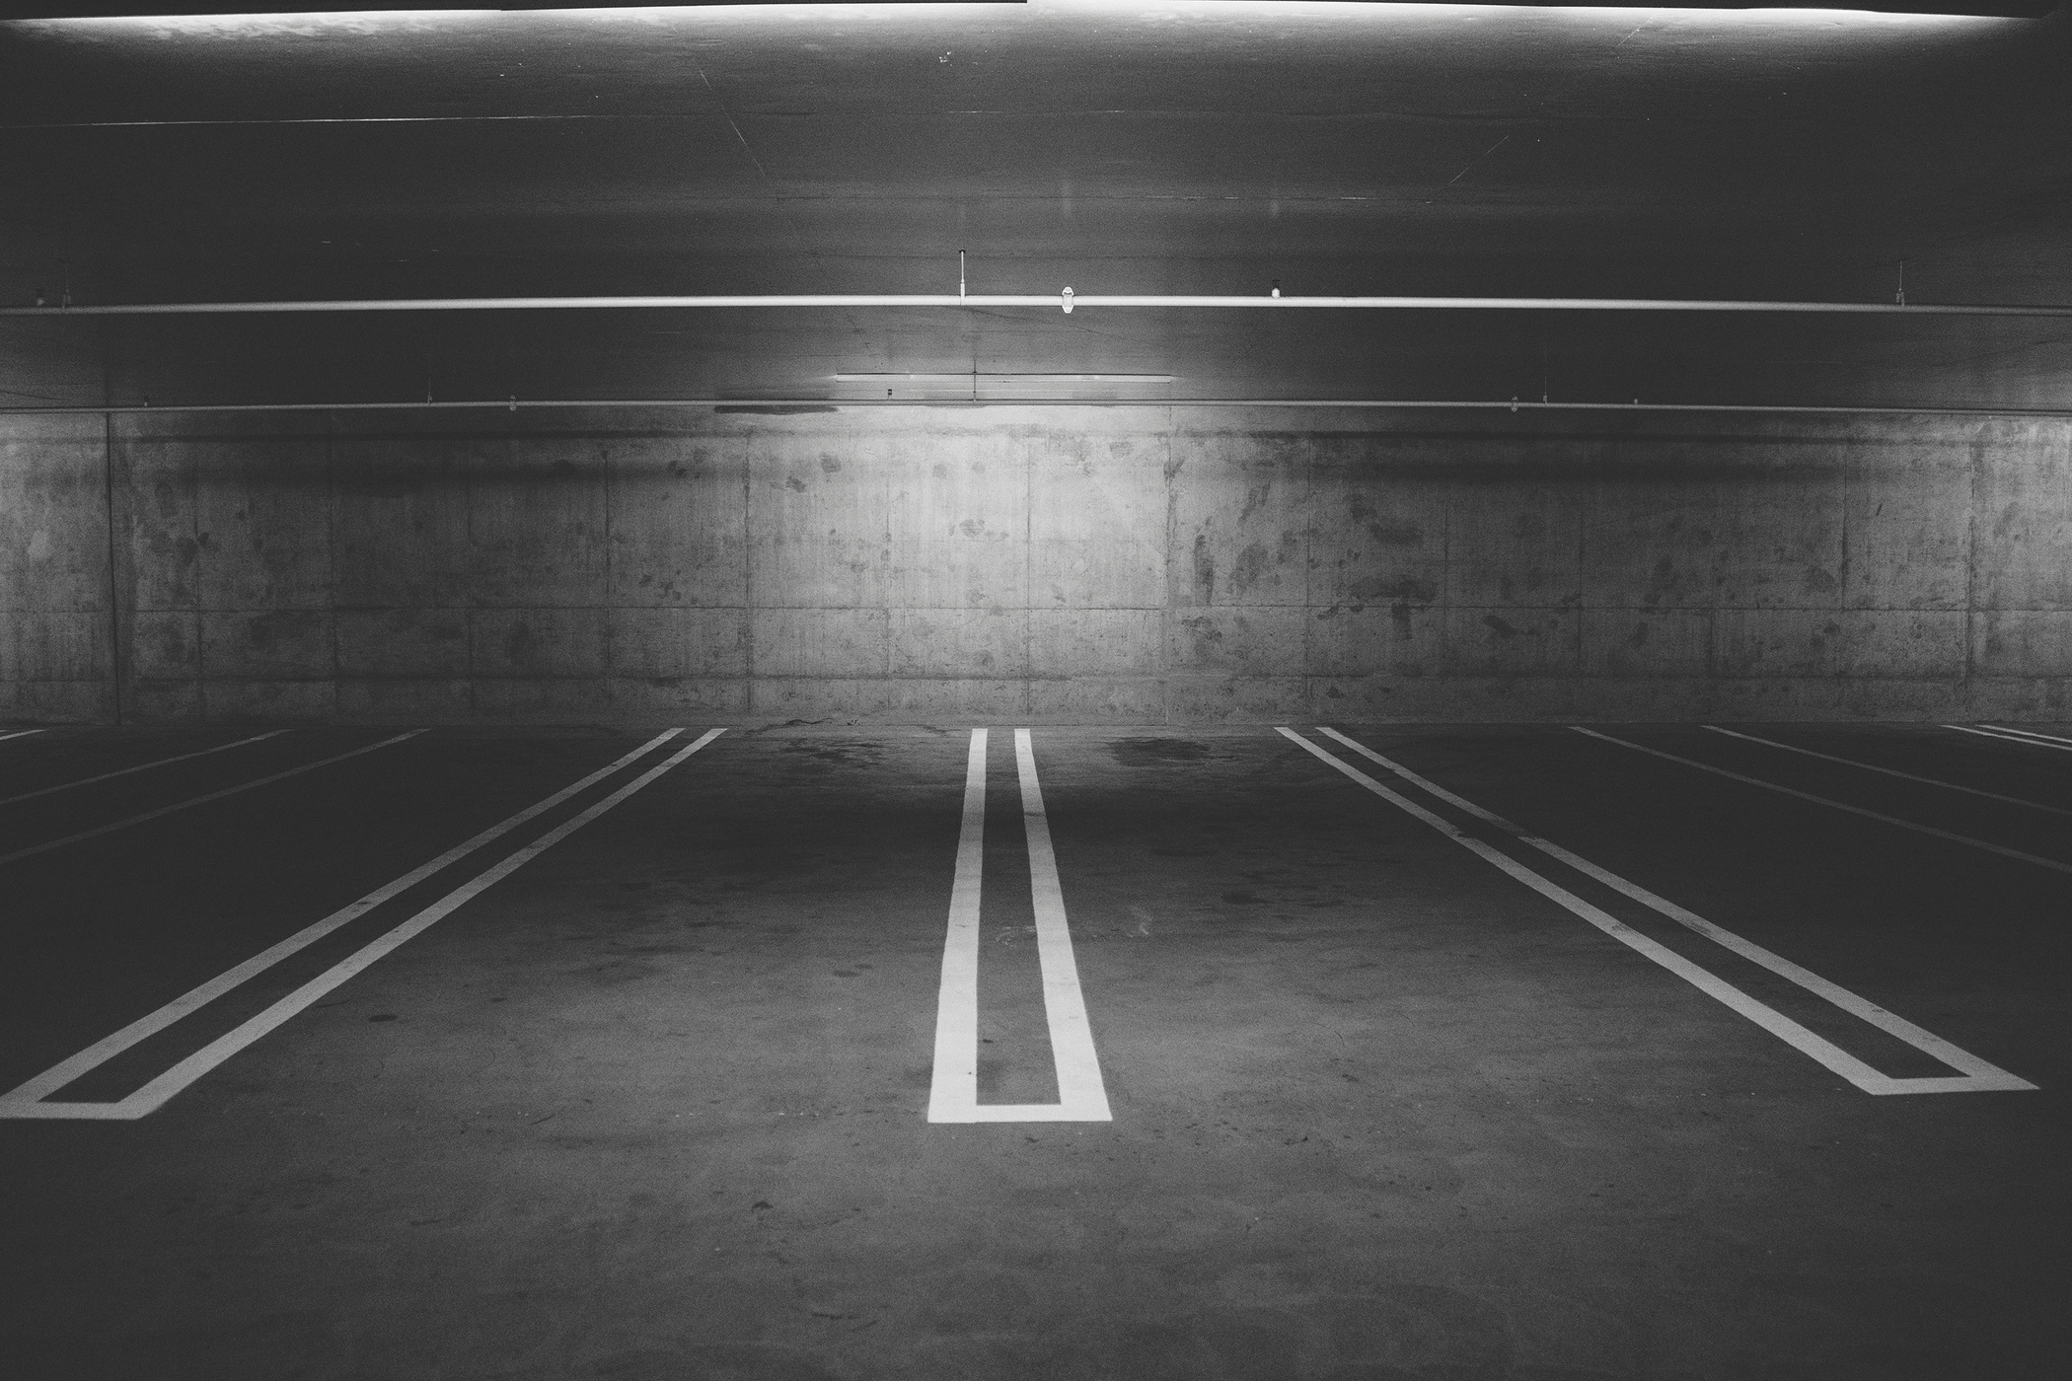

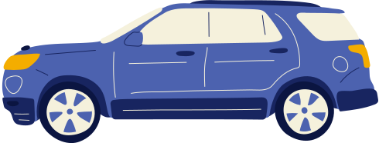
SMART
PARKING
A SYSTEM THAT SAVES YOUR TIME
Gador
Hana
Albert
David
ENSSAT SUMMER SCHOOL 2023

Slide 2
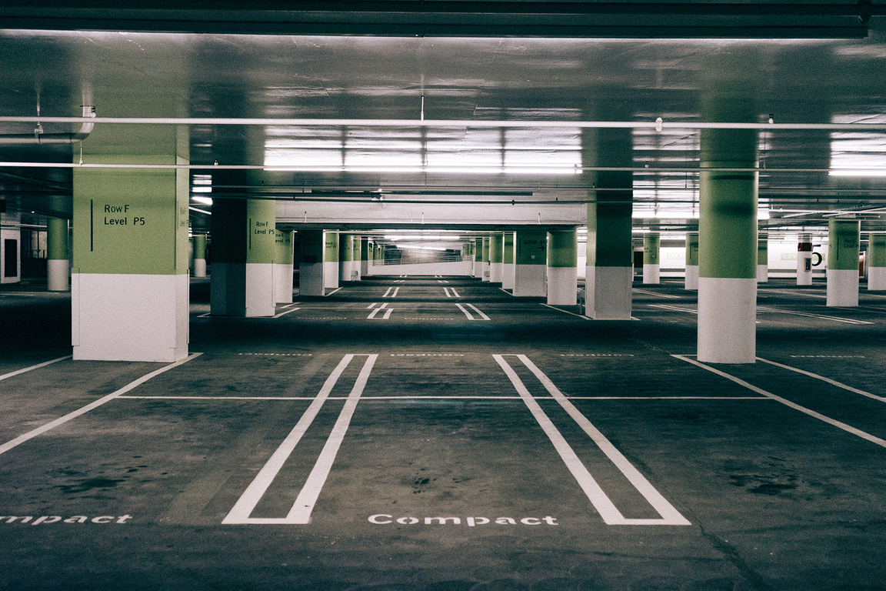
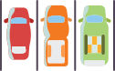

CONTENT
Problem
Solution
Components
How it works
Technical Tasks
Improvements
Use Cases
Conclusions

Slide 3
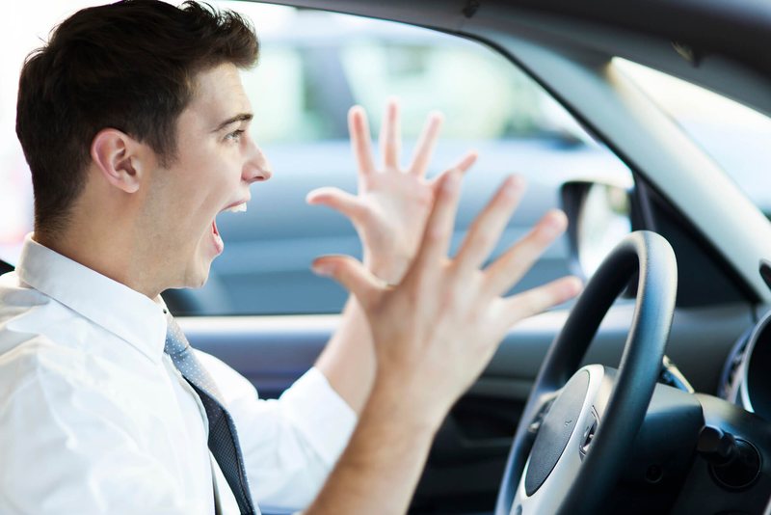
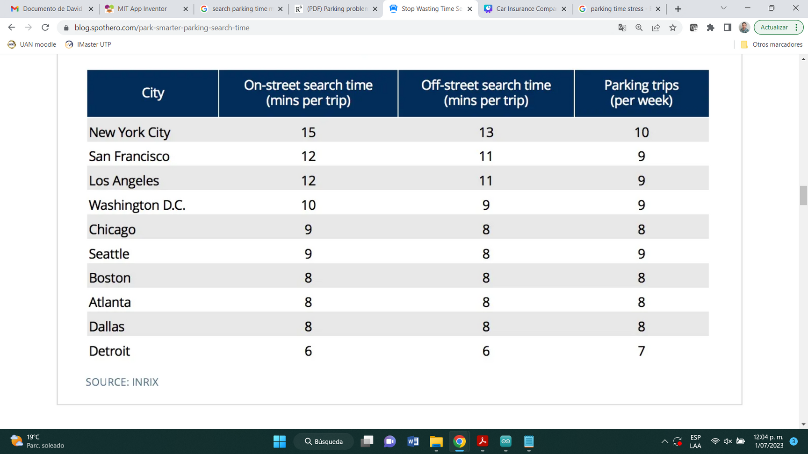
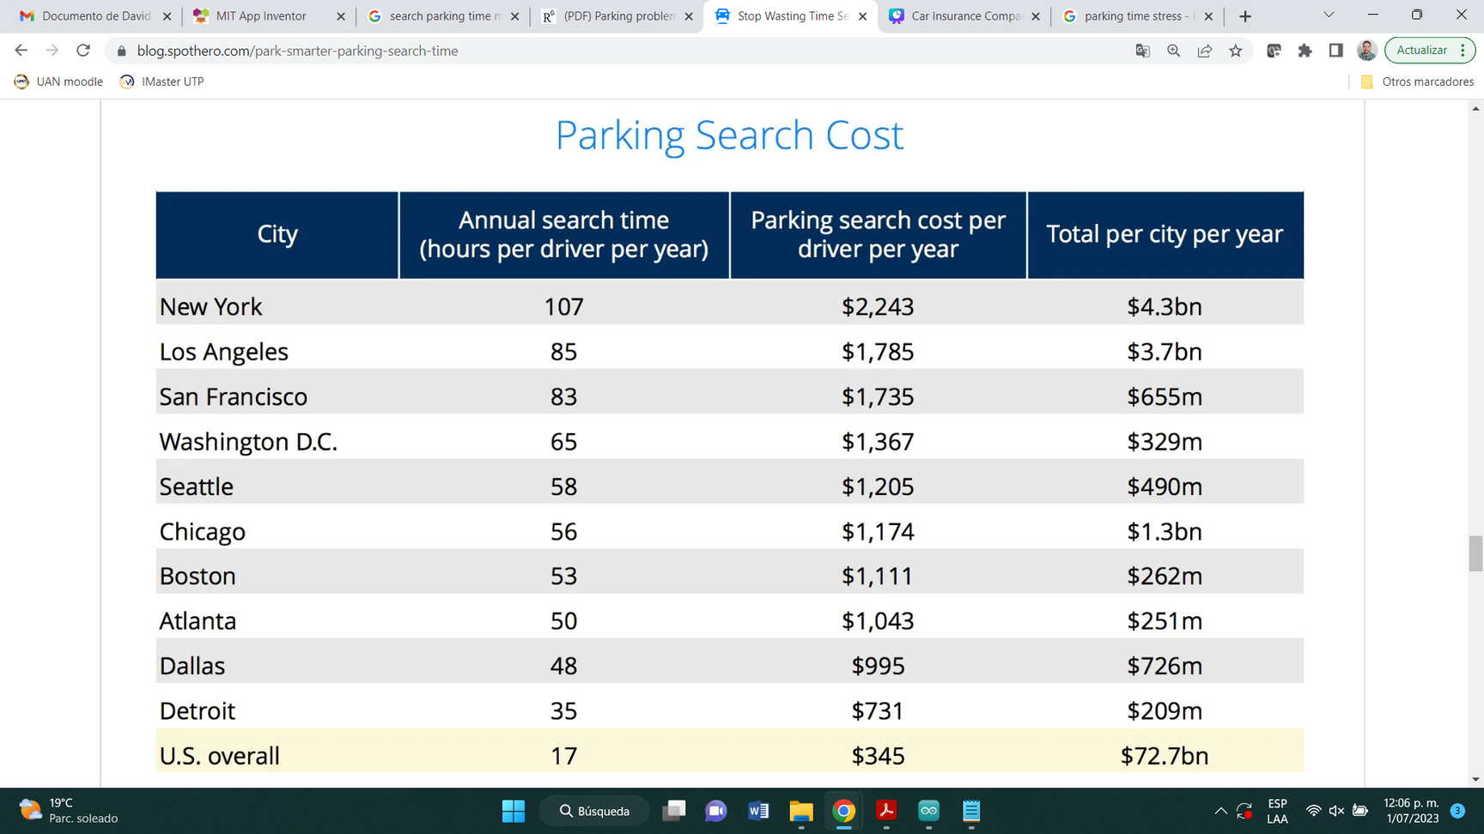
PROBLEM
How much time do you spend looking for parking on the street or in a mall?
THIS IS A DIFFICULT TASK
THAT DEPENDS ON:
1
HOUR / DAY / SEASON
2
CITY AREA
3
CITY / COUNTRY

Slide 4

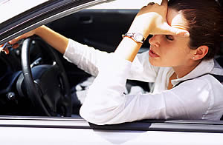
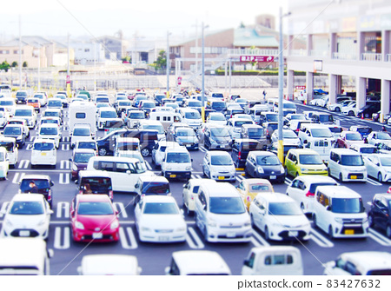
PROBLEM
3
TRAFFIC INCREASE
4
POLLUTION
1
WASTE TIME
5
INEFFECTIVE RESOURCE MANAGEMENT
2
STRESS
6
COST INCREASE

Slide 5
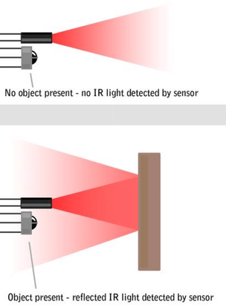
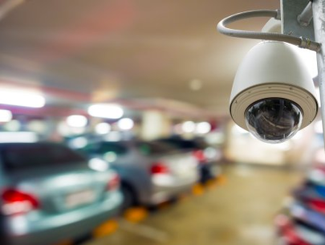
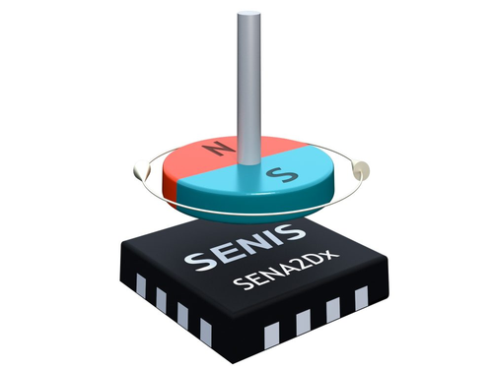
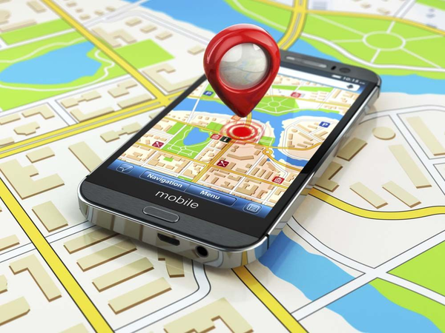
PROBLEM
OTHER TECHNOLOGIES
DEPENDS ON THE LIGHT CONDITIONS
EXPENSIVE AHD HIGH COMPUTATIONAL COST
MAGNETIC
FIELD
SENSORS
VIDEO-BASED SYSTEMS
GPS-BASED
APPS
INFRARED
(IR) SENSORS
LOST SIGNAL INDOOR
LOW ACCURACY
INTERFERENCE FROM ELECTROMAGNETIC SIGNALS

Slide 6

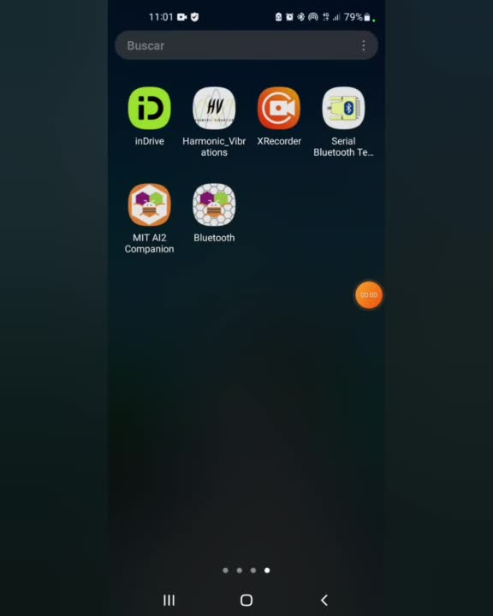
SMART
PARKING
SOLUTION
A simple system that give you the slot number at the parking entrance

Slide 7

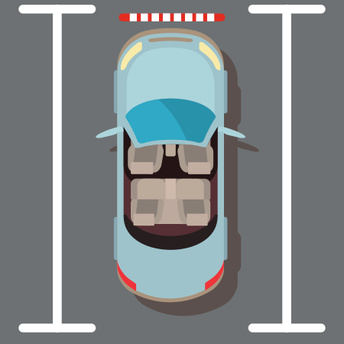
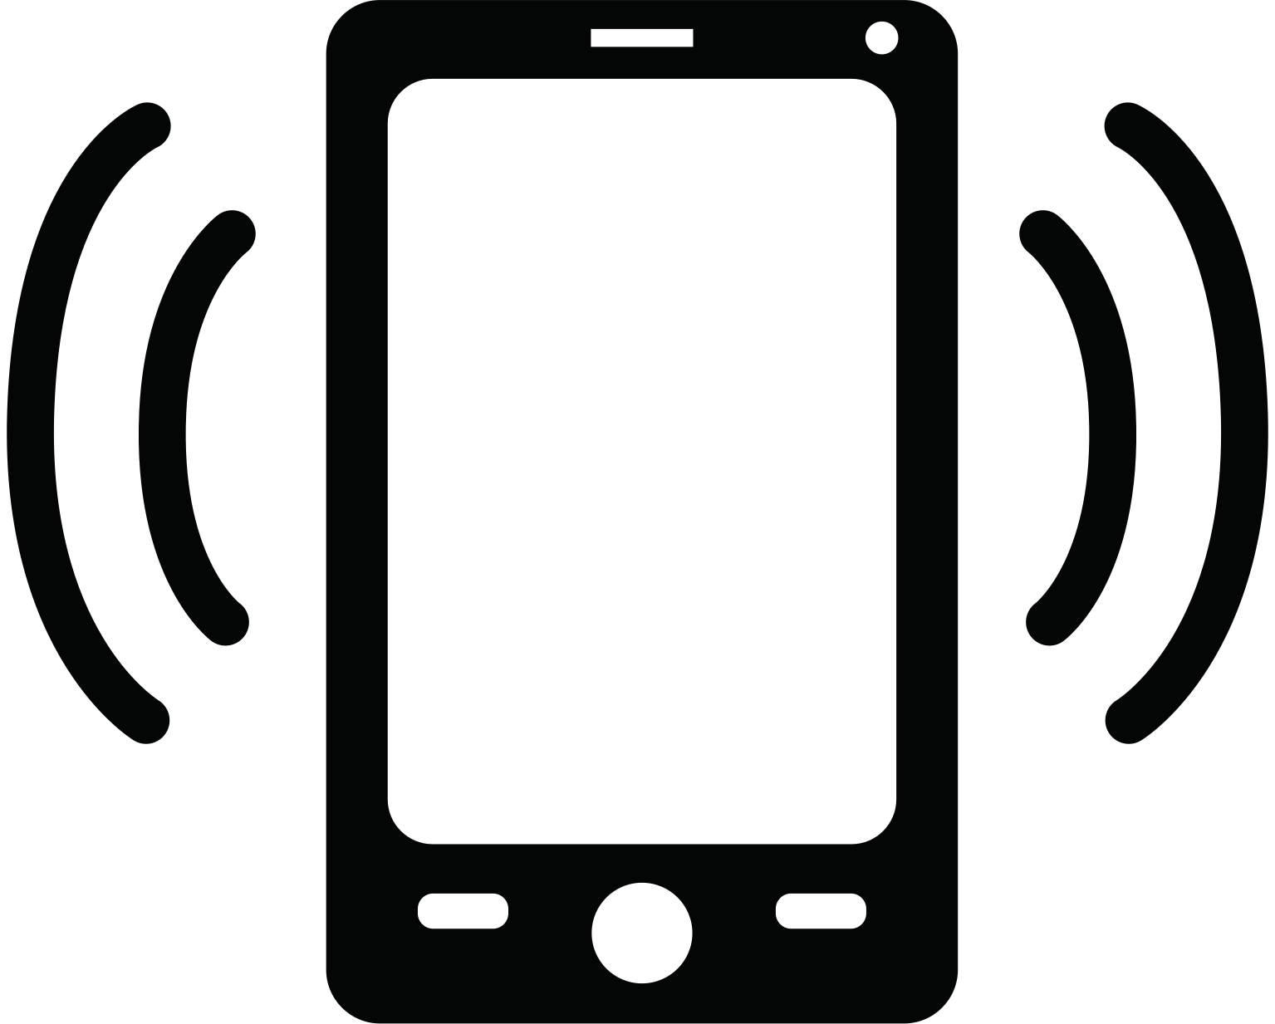
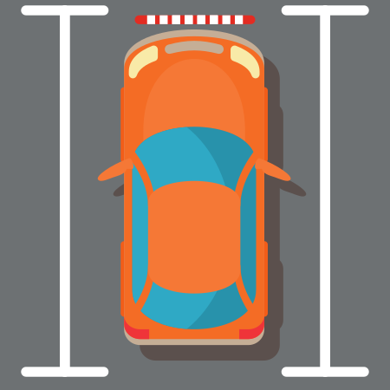
SOLUTION
uses ultrasonic sensors to detect the cars
uses bluetooth to communicate
Reduces the time spent for parking
Allows data analysis
low interference, not affected by lighting conditions, cost-effective solution, no complex algorithms

Slide 8
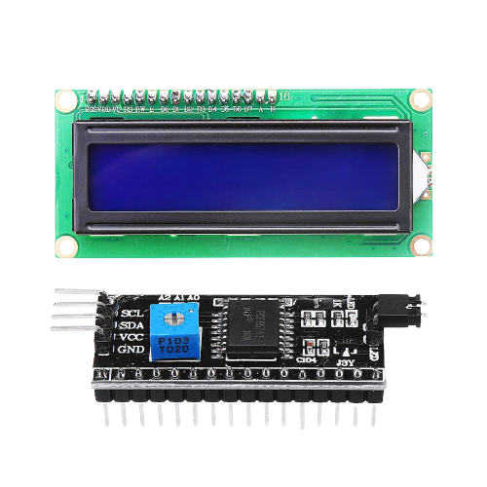
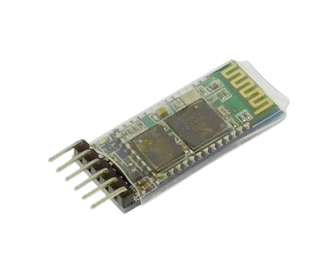
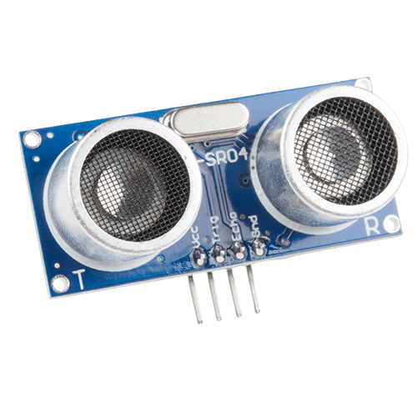
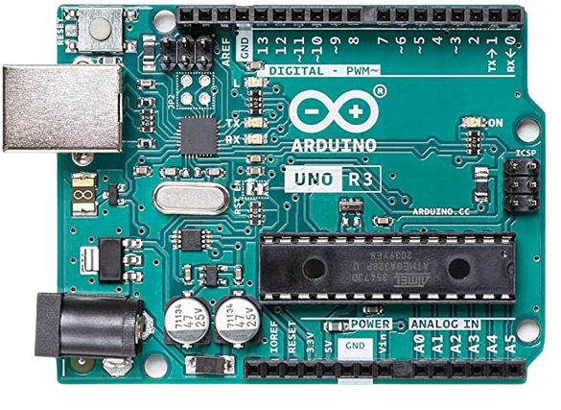
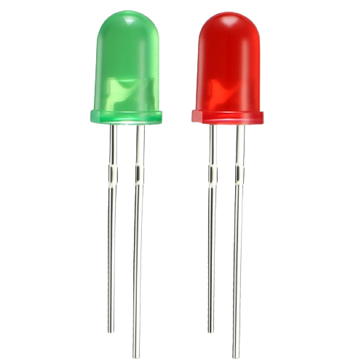
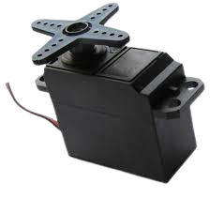
Components

Slide 9
Arduino UNO
microcontroller board
14 digital I/O pins
6 analog I/O pins
Microchip ATmega328P
I2C peripherals: 1
USART peripherals: 1

Slide 10
HC-SR04
digital sensor
ultrasonic waves
working current: 16mA
range: 2cm - 700cm
accuracy: up to 3mm

Slide 11
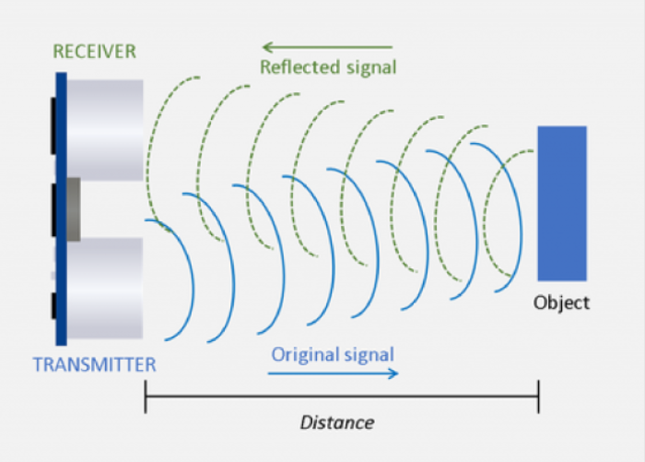
HC-SR04
speed of sound: 343 m/s
speed formula: distance / time
distance: (speed * time) / 2

Slide 12
HC-05
bluetooth module
2.4GHz radio transceiver
baud rate: 38400
modes: master/slave

Slide 13
LCD
liquid-crystal display
matrix of pixels (16x2)
i2c communication

Slide 14
Servomotor
rotary actuator
precise control

Slide 15
LED
Light Emitting Diode
semiconductor device
voltage drop:
RED: 1.63V -> 2.03V
GREEN: 1.9V -> 4V

Slide 16

How it works

Slide 17
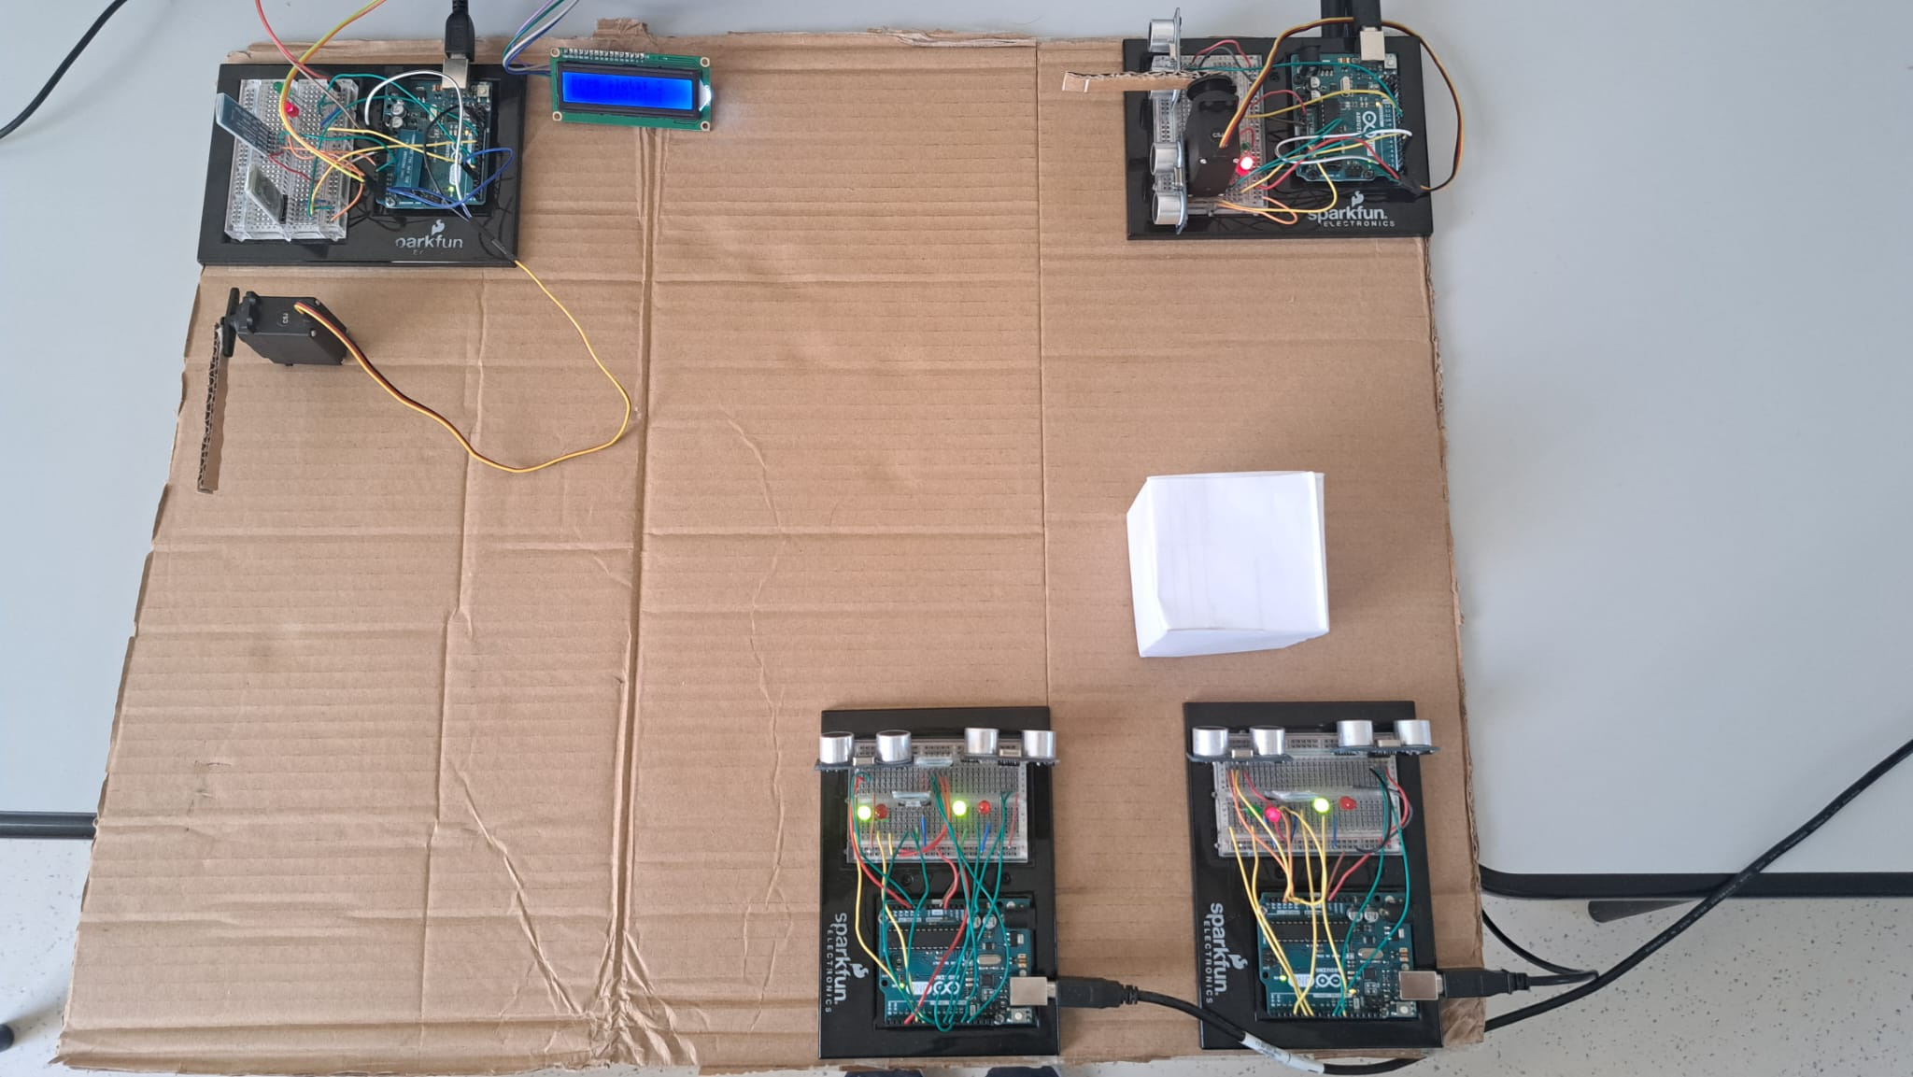

BT5
arduino 3
phone

Slide 18
BT4
BT3
arduino 2

Slide 19
BT3
BT2
arduino 2

Slide 20
BT1
BT2
arduino 1

Slide 21
BT1
arduino 1

Slide 22
arduino 1

Slide 23
arduino 3
BT1
arduino 1

Slide 24
BT1
BT2
arduino 2
arduino 1

Slide 25
arduino 2

Slide 26
BT3
arduino 2

Slide 27
arduino 3
BT4
BT3
arduino 2

Slide 28
BT5
arduino 3
BT4

Slide 29
BT5
arduino 3
BT4
phone

Slide 30

Technical Task

Slide 31
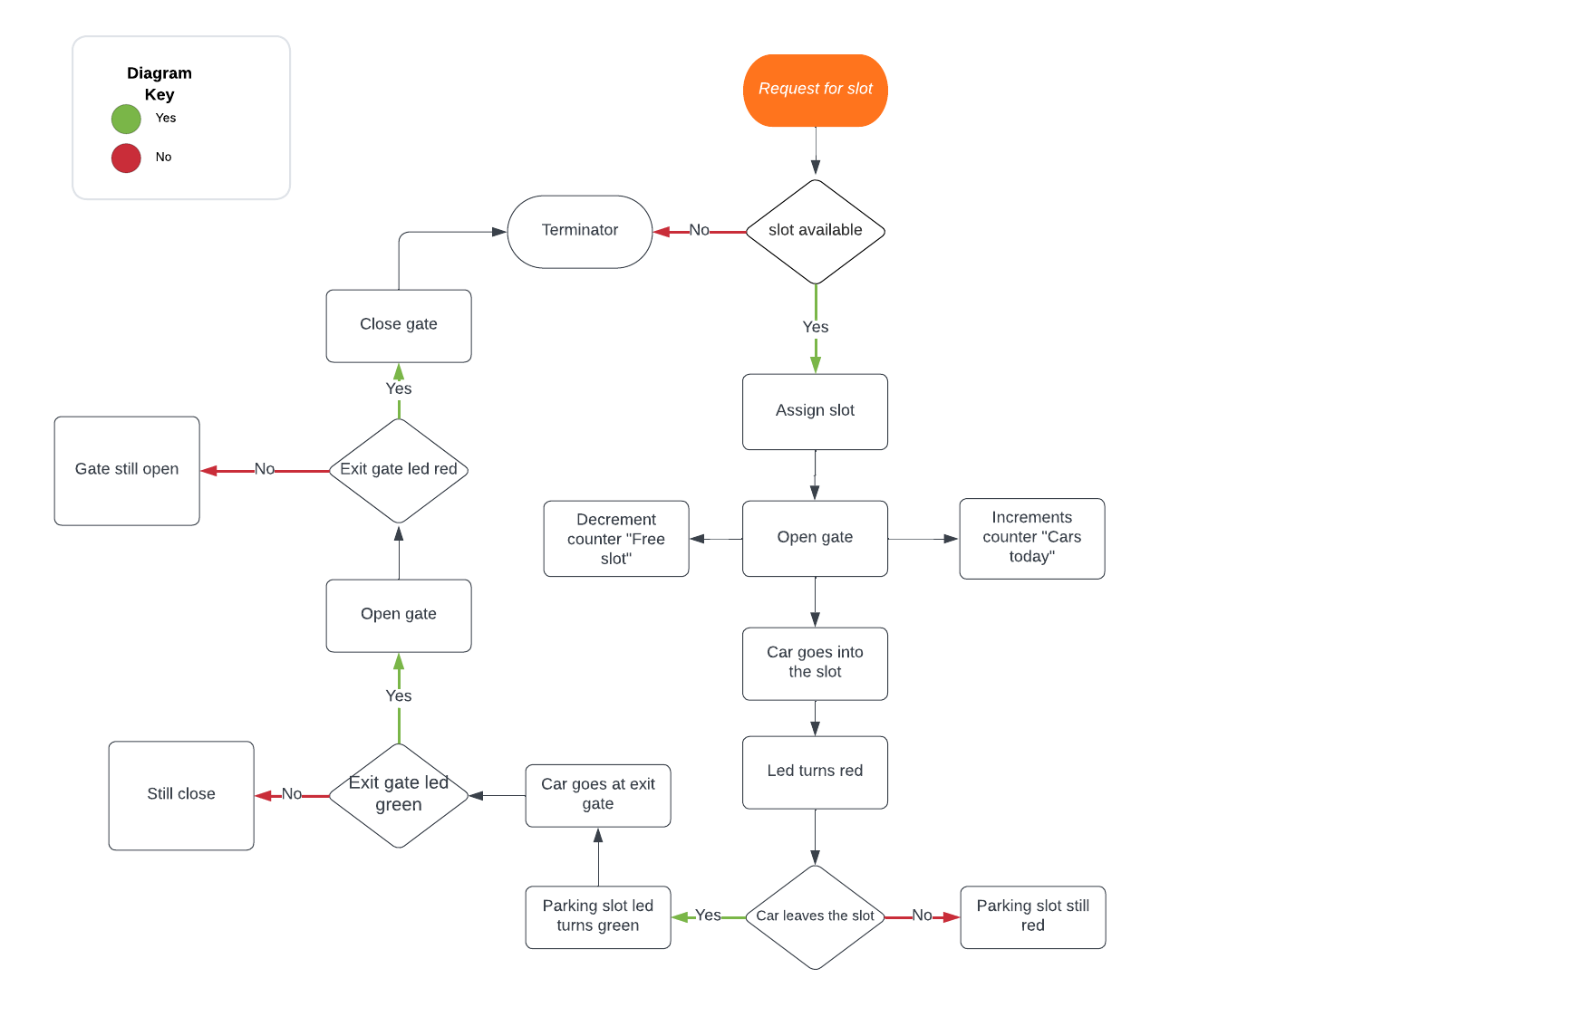
Functional
Diagram

Slide 32
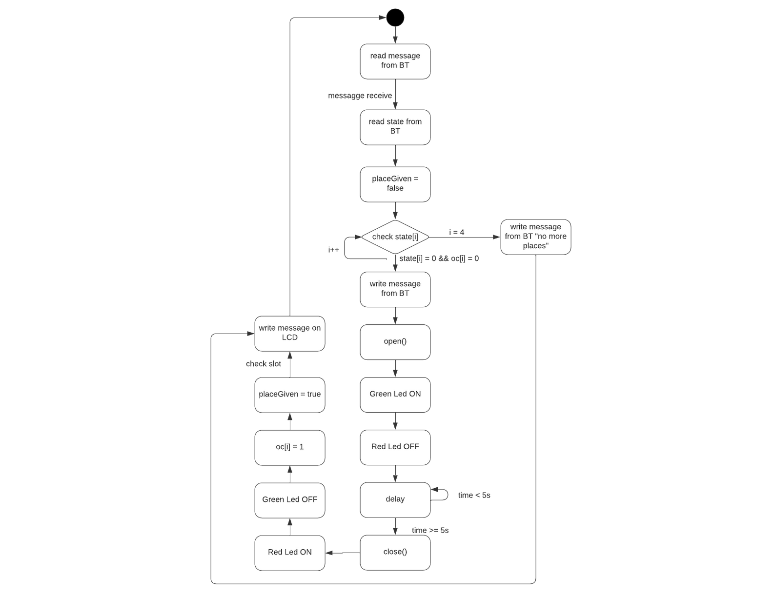
Statecharts
Entrance

Slide 33
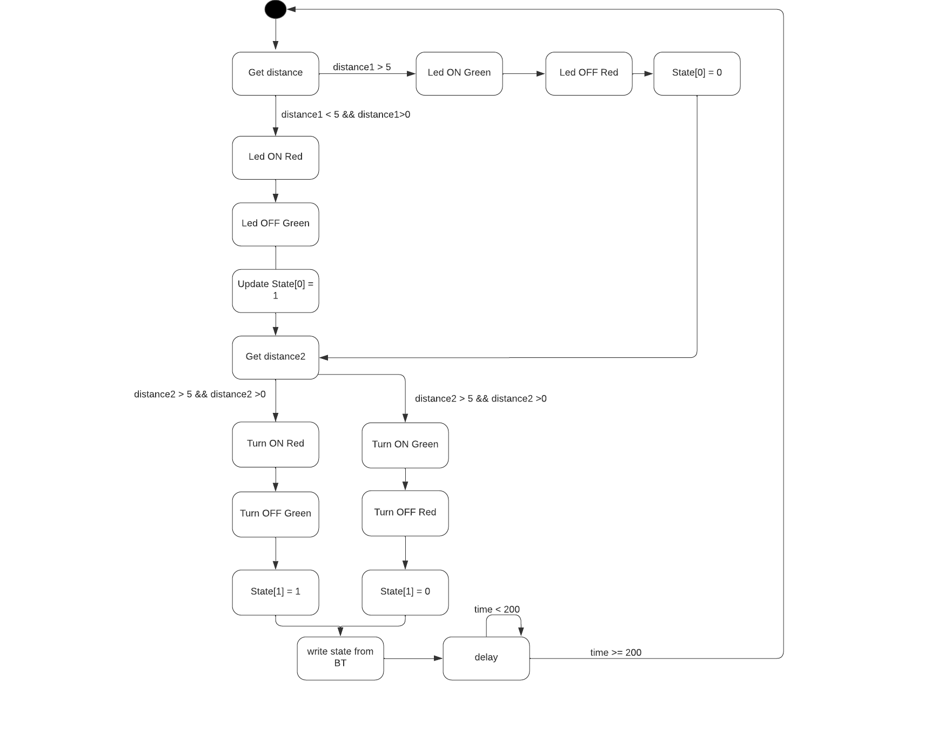
Statecharts
Sensor board 1

Slide 34
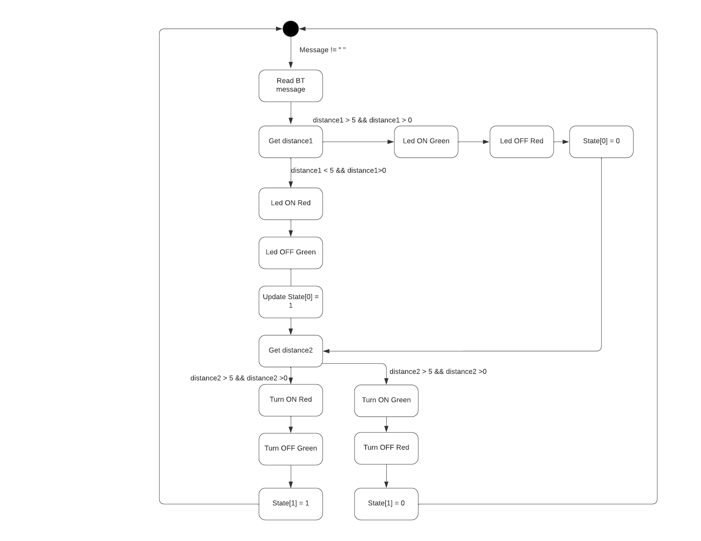
Statecharts
Sensor board 2

Slide 35
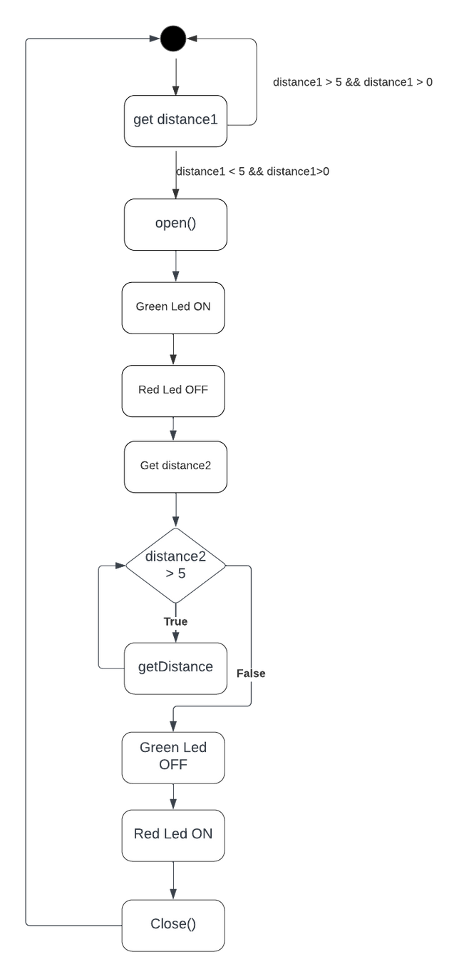
Statecharts
Exit

Slide 36
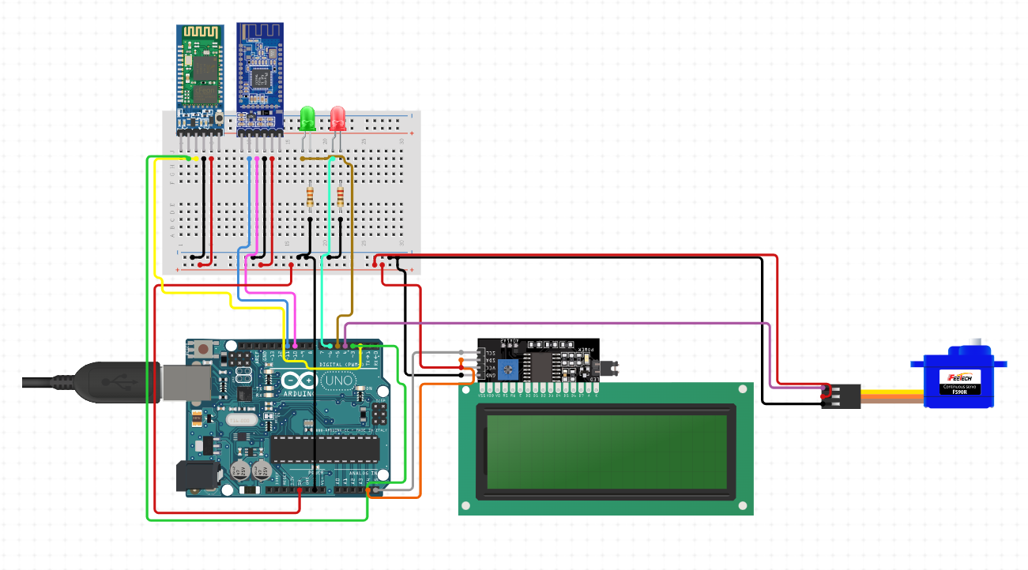
Arduino Scheme
Entrance

Slide 37
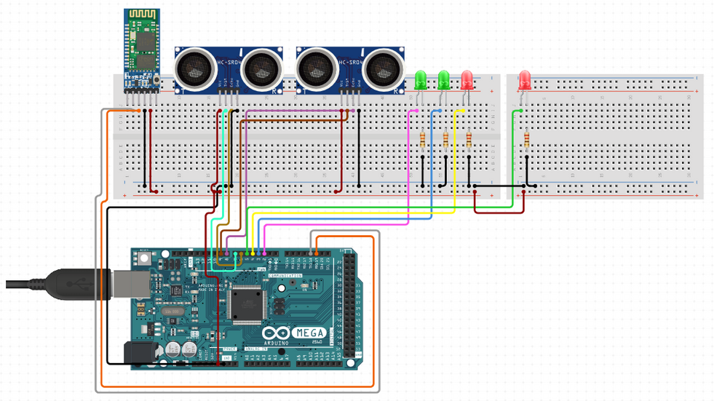
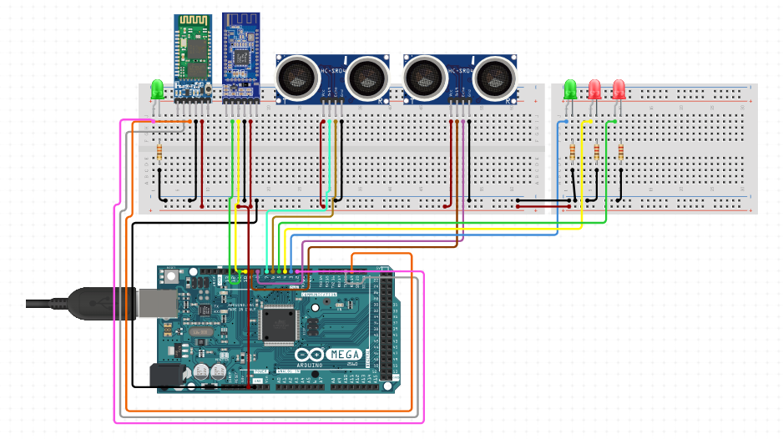
Arduino Scheme
Parking sensors

Slide 38
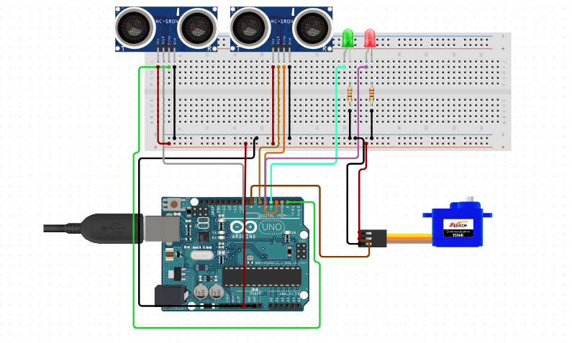
Arduino Scheme
Exit

Slide 39




Use Cases

Slide 40

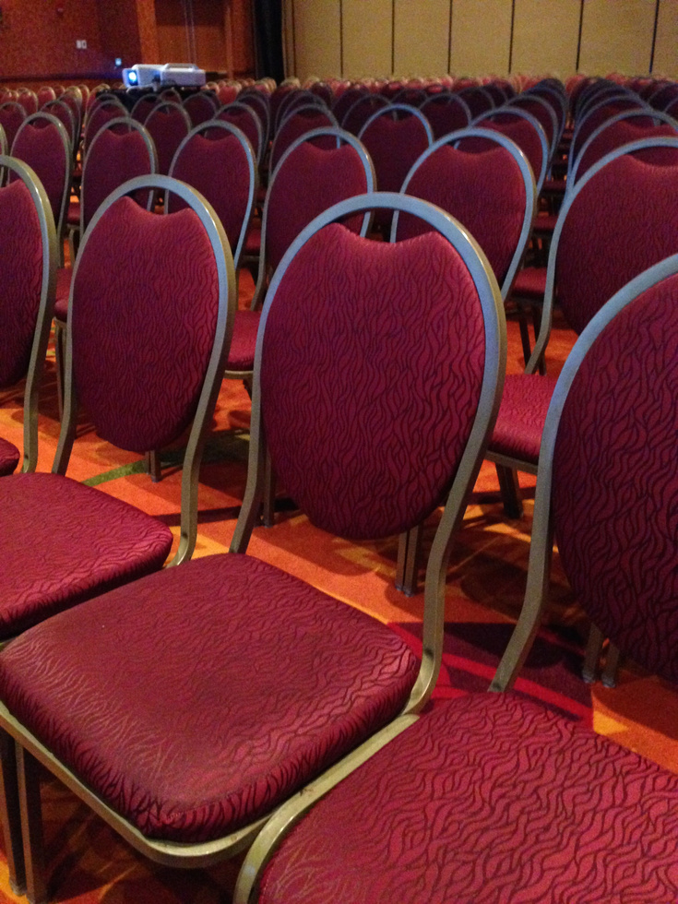
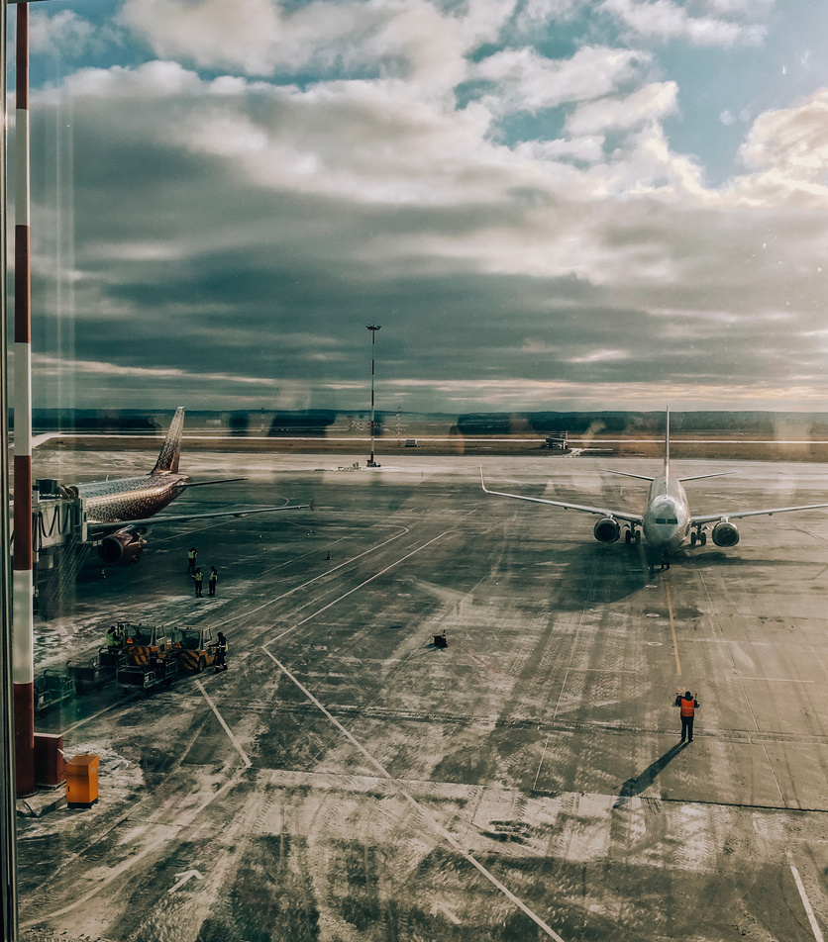
Shopping Malls
Event Venues
Airports

Slide 41

Improvements
1
Provide a ticket dispenser
2
New algorithm for Master-slave shift
3
Reduce the number of Bluetooth modules
4
Ventilation system

Slide 42
Conclusion

Slide 43



Increases
Decreases
Optimization of parking spaces in urban and private areas
Reputation of being a greener city/facility
Real-time information on available parking spaces
Parking revenues
Traffic volume
Gas emissions
Time spent
Driver's anxiety or fatigue

Slide 44



